Slide 1

Data Analysis & Programming for OM Databases
Wout van Wezel
w.m.c.van.wezel@rug.nl

Slide 2
Contents
Volume
Variety
Velocity
Why are ‘traditional’ databases not suitable for Big Data?
How do ‘modern’ databases solve these problems?
Representation, storage, computer architecture

Slide 3
Data
In programming, we always need access to data.
Most basic element in all databases:
A characteristic of an entity has a value
The collection of all values is a database

Slide 4
Data, example
Conceptually
A person has an age, length, and hobbies
Store data as variable in Python:
age = 40
length = 178
hobbies = ['cars', 'music', 'cocktails']
In Python, as dictionary:
person = { 'age': 40,
'length': 178,
'hobbies': [ 'cars',
'music',
'cocktails'
]
}

Slide 5
Data
In a CSV file
Even better, for characteristics that can have multiple values, we create 2 CSV files:
age, length, hobbies
40, 178, 'cars, music, cocktails'
45, 183, 'walking, dogs'
BSN, age, length
12345, 40, 178
54423, 45, 183
BSN, hobby
12345, cars
12345, music
12345, cocktails
54423, walking
54423, dogs
* BSN = ‘burgerservicenummer’, unique number for each person in NL

Slide 6
Data manipulation
Data usually needs to support the following operations:
Create
Read
Update
Delete
It is easy to imagine how these CRUD tasks can be done in CSV files:
C: Read the file, add a line, save the file
U: Read the file, change a line, save the file
D: Read the file, delete a line, save the file

Slide 7
Databases
Using csv files is a suitable way to handle data in small programs.
However, there are several ways in which it can go wrong:
If two programs simultaneously change the data, we could have a conflict.
If the computer crashes when I am writing the file, the database is corrupt.
If the file is too big to load in the computer’s memory, we have a problem.
Even if I can store the whole file in memory, this approach would be very slow for big files.

Slide 8
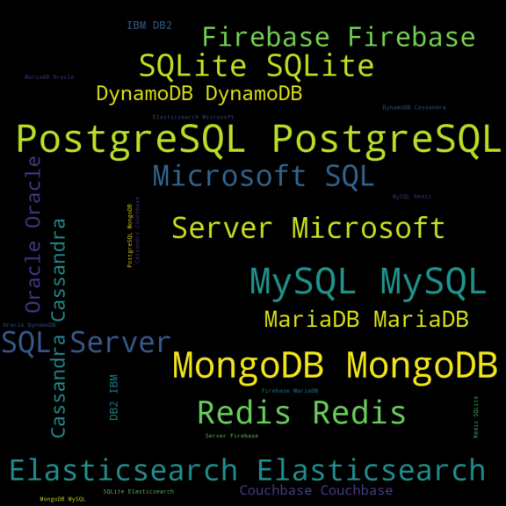
DBMS
A better alternative is to not use files at all, but use dedicated programs for data CRUD.
Such programs are called Database Management Systems (DBMS)
DBMS is the backbone of most computer programs.

Slide 9
DBMS, terminology
Relational Database systems, e.g., Oracle, SQL Server, MySQL, SQLite
Table: similar to a CSV file, but stored more efficiently
Row / Record: similar to a row in a CSV file
Column / Field: a specific characteristic (e.g., all values of age)
Relation: Persons and Hobbies are linked by the BSN
Query: a command you give to the database. Can be any of the CRUD operations. Example: SQL
Index: Sorted data, explained later

Slide 10
DBMS, terminology
Table
Column
BSN age length
12345 40 178
54423 45 183
Row
BSN hobby
12345 cars
12345 music
12345 cocktails
54423 walking
54423 dogs
1:n Relation

Slide 11
DBMS, SQL
SQL (pronounce as sequel) = Structured Query Language
Most DBMS’s support SQL. Programs (such as you create in Python) can send such SQL queries to the DBMS, and the DBMS then handles everything that is needed.
Not used in DAPOM, but some examples:
Create: insert into Persons (BSN, age) values (12343, 18)
Update: update Persons set length=165 where bsn=12343
Delete: delete from Persons where age<50
Search: select * from Persons where age>50 and length<180
https://pandas.pydata.org/docs/getting_started/comparison/comparison_with_sql.html

Slide 12
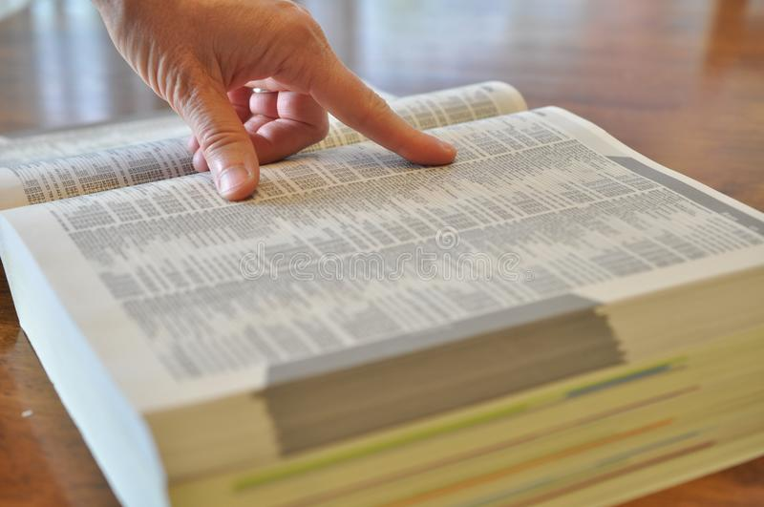
Index
Indexes are what make DBMS’s fast
Suppose you have 17 million people in your table, and you search for the person with BSN=12345. I would need to iterate all records, and compare the BSN of that record with 12345.
On average, I would need to access 8.5 million records.
In an index, all values of a column are stored sorted.

Slide 13
Index: binary search
The index of a column is stored separately from the main table.
Each row in the index has the value, and a reference to the row in the table.
Suppose I am searching for the age of the person with BSN 14112243
Select Age from Persons where BSN=14112243
To search, the DBMS starts in the middle: 13730387
value | recordNr
11239137 | 5
11368244 | 3
11847784 | 1
12740055 | 8
13218725 | 11
13683258 | 9
13730387 | 14
14112243 | 6
14427228 | 2
16700210 | 12
16877418 | 13
17341746 | 7
17782852 | 4
17783866 | 10

Slide 14
Index: binary search
13730387 is smaller than 14112243, so I know for sure that 14112243 cannot be found in the rows before 13730387.
In one step, I cut my search space in half.
I now start in the middle of the rest: 16877418
value | recordNr
11239137 | 5
11368244 | 3
11847784 | 1
12740055 | 8
13218725 | 11
13683258 | 9
13730387 | 14
14112243 | 6
14427228 | 2
16700210 | 12
16877418 | 13
17341746 | 7
17782852 | 4
17783866 | 10

Slide 15
Index: binary search
16877418 is larger than 14112243, so I know for sure that 14112243 cannot be found in the rows after 16877418.
I have again cut my search space in half.
I again start in the middle of the rest: 14427228.
value | recordNr
11239137 | 5
11368244 | 3
11847784 | 1
12740055 | 8
13218725 | 11
13683258 | 9
13730387 | 14
14112243 | 6
14427228 | 2
16700210 | 12
16877418 | 13
17341746 | 7
17782852 | 4
17783866 | 10

Slide 16
Index: binary search
14427228 is higher than 14112243, so I know that all rows after 14427228 will not have 14112243.
value | recordNr
11239137 | 5
11368244 | 3
11847784 | 1
12740055 | 8
13218725 | 11
13683258 | 9
13730387 | 14
14112243 | 6
14427228 | 2
16700210 | 12
16877418 | 13
17341746 | 7
17782852 | 4
17783866 | 10

Slide 17
Index: binary search
I again start at the middle of the remainder: 14112243, which is the one I was looking for.
I now know that I need to retrieve record 6 from my table.
value | recordNr
11239137 | 5
11368244 | 3
11847784 | 1
12740055 | 8
13218725 | 11
13683258 | 9
13730387 | 14
14112243 | 6
14427228 | 2
16700210 | 12
16877418 | 13
17341746 | 7
17782852 | 4
17783866 | 10

Slide 18
Index
In general, binary searching in a sorted list of size n takes at maximum log2(n) steps.
So if I have stored the values of a column in a sorted index, I can find everything blazingly fast:
10^82 = estimated number of atoms in the universe
n | log2(n)
100 | 7
1,000 | 10
10,000 | 14
100,000 | 17
1,000,000 | 20
1,000,000,000 | 30
1,000,000,000,000 | 40
1E+82 | 273

Slide 19
This kind of searching is used to quickly find the records of a query, for example:
select * from Persons where age>50 and length<180
Note that sorting a list of (for example) 1.000.000.000 items is not trivial at all.
Each time a value changes, the indexed column must be recreated, which is the bottleneck in DBMS's:
update Persons set length=165 where bsn=12343

Slide 20
Limits of traditional DBMS’s
Relational DBMS’s are very powerful, fast, and reliable, but cannot handle:
Really high volumes. Data files and index files need to be on the same computer, and creating or updating an index of a huge number of values takes some time.
High variety. You must know which fields (=columns) you need beforehand.
They do a poor job in full text
search and data analytics
(calculations on data)
Volume
Variety
Velocity
X
X

Slide 21
Computer architecture
To understand why row oriented DBMS’s are not really suitable for data analytics, a bit of knowledge of the architecture of a computer is needed.
This is the basic model of a computer:
Speed of processing is usually assumed to be a function of complexity of the problem and the input size.
input
compute
input

Slide 22
Computer architecture
There are three characteristics of modern computers which make relational databases less suitable for Big Data:
1. A computer processor has multiple cores to spread the workload
2. A computer has different kinds of memory (slow and fast)
3. A processor core can do multiple calculations in one step
So called NoSQL databases make better use of these characteristics and can therefore handle Big Data much better.

Slide 23
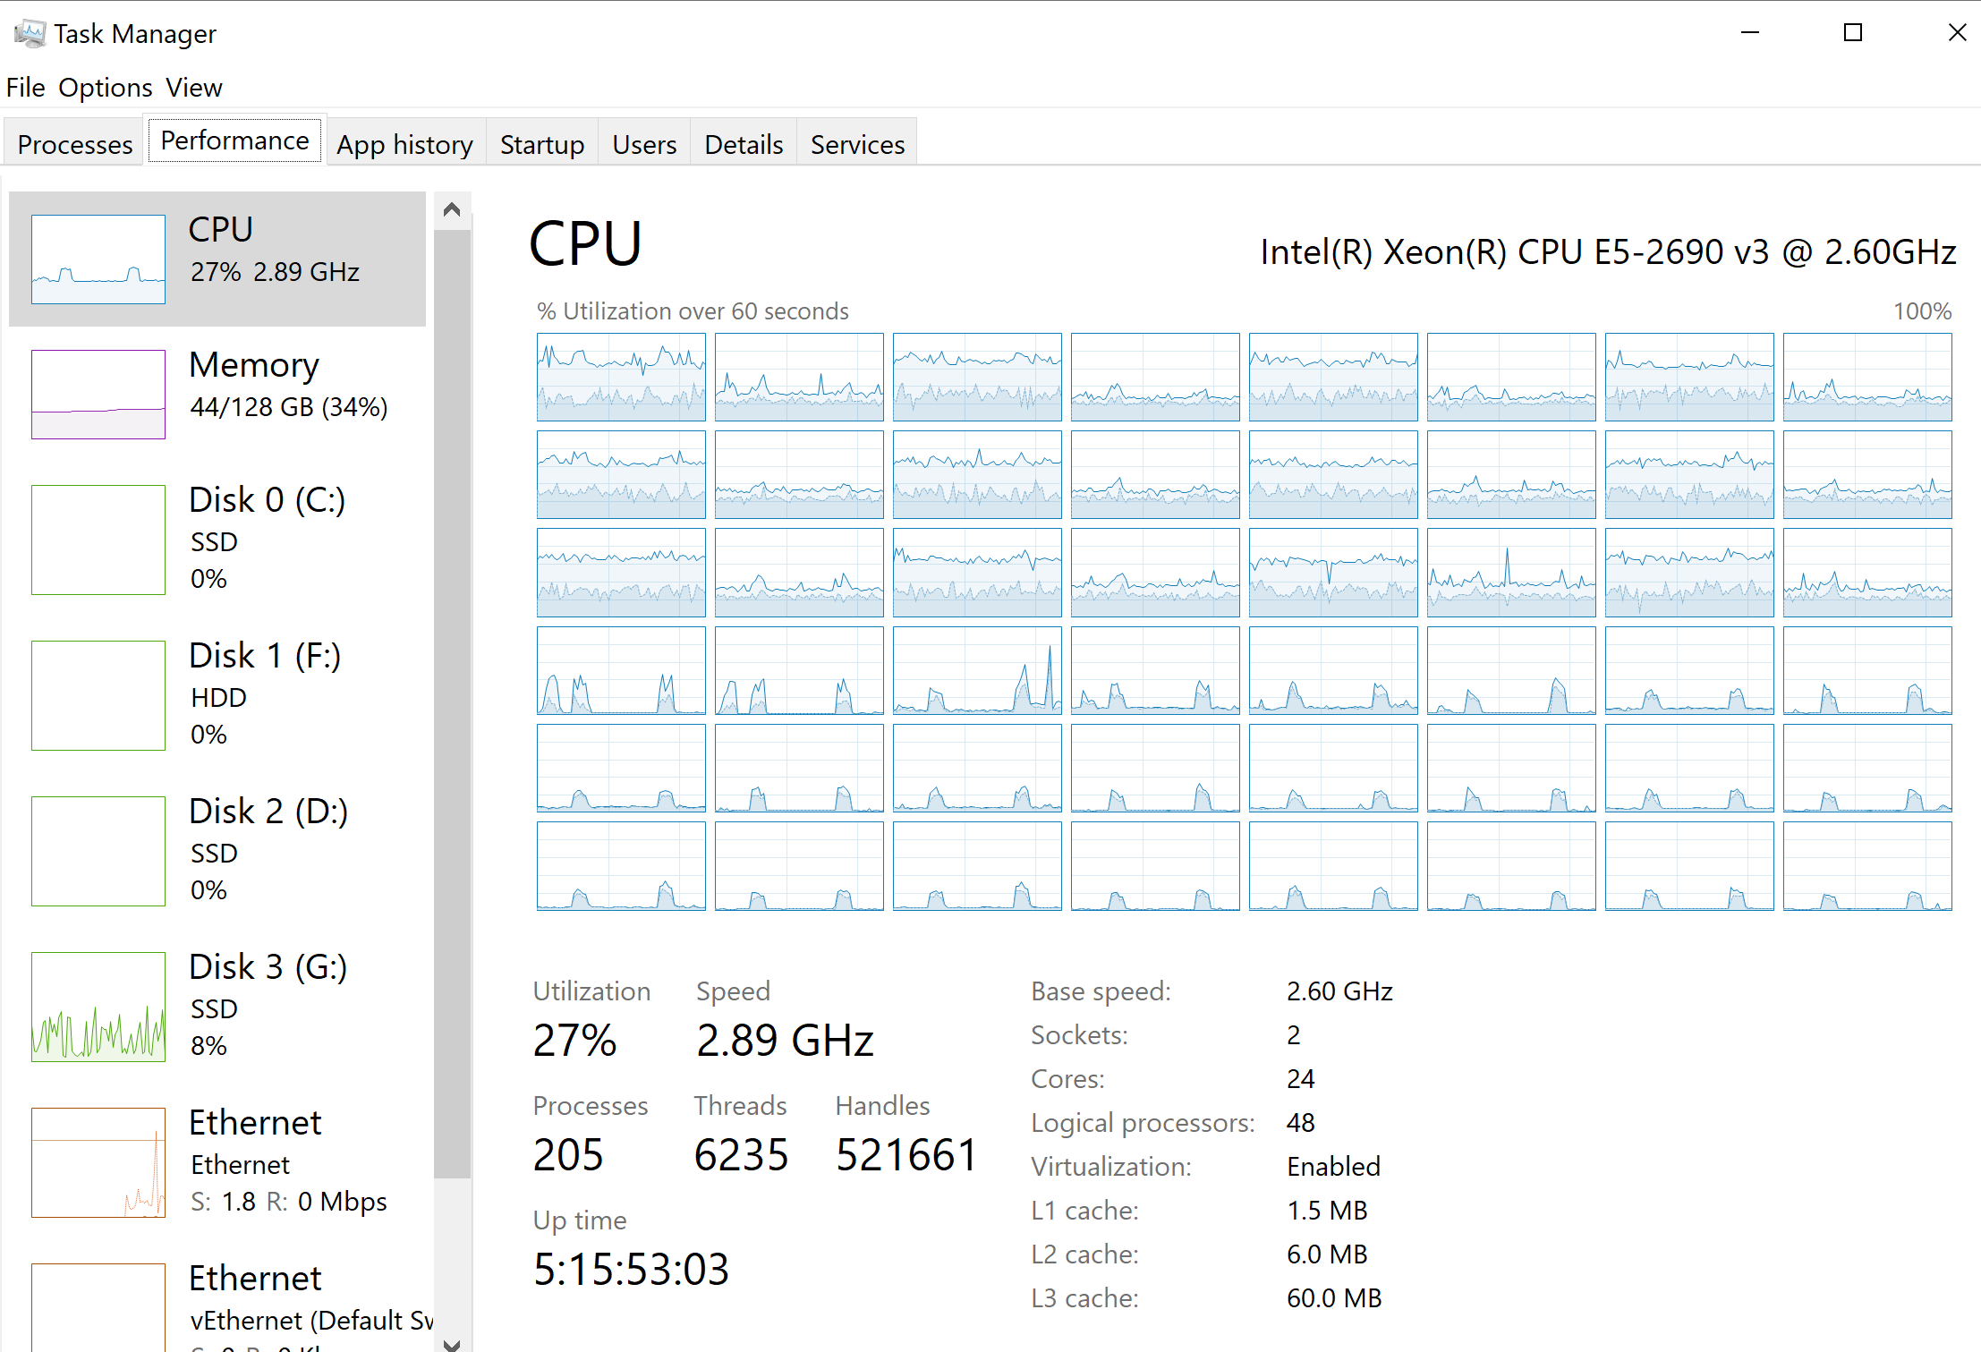
Perform multiple tasks
simultaneously
Instructions
per second
Different kinds of
memory

Slide 24
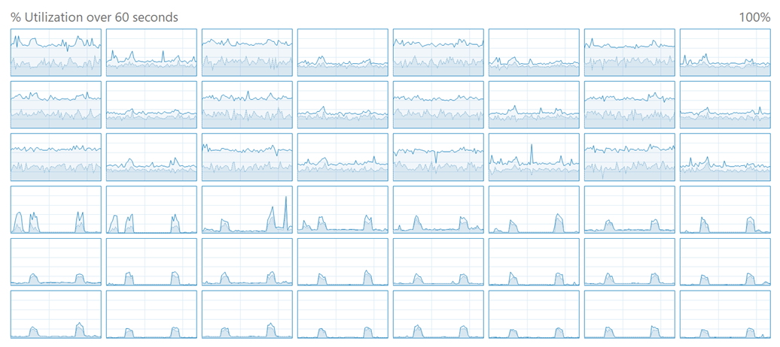
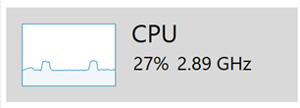
Computer architecture
On my computer I have 2 Intel E5-2690v3 processors, with 12 cores each. So 24 cores in total.
Each core can do 2 tasks in parallel. I can execute 48 tasks in parallel, all running at full speed, so each doing 2.890.000.000 instructions per second.
If I can design my algorithm (for example, finding an item in a list) such that I can spread the work over all those processors (=multithreading), my program will run 48 times faster.

Slide 25
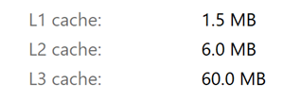

Computer architecture
A task (for example, searching in a sorted list) is always done on memory.
Most processors have different kinds of memory:
SSD or harddisk for persistent storage
Regular RAM
L3 processor cache
L2 processor cache
L1 processor cache
Processor registers

Slide 26
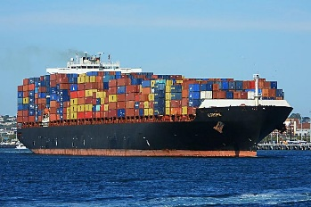
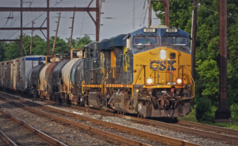
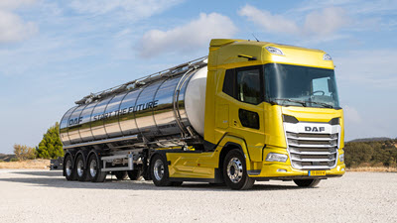

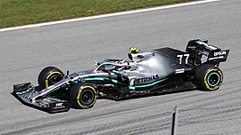
Computer architecture
SSD
RAM
L3
L2
L1
Register

Slide 27
Computer architecture
The terms are not so important here. What is relevant, is that each level has different size, and different speed.
Harddisk, 1 to 20 terabytes, 3 ms (miliseconds)
SSD: 0.5 to 4 terabytes, 20 us (microseconds)
Regular RAM: 16 to 256 Gigabyte, 100 ns (nanoseconds)
L3 processor cache: megabytes: 30ns
L2 processor cache: megabytes: 7ns
L1 processor cache: megabyte, 0.5 ns
Processor registers: 256 bytes, 0.3 ns
(Approximate numbers, depends on computer and processor)

Slide 28
Computer architecture
Remember searching in a sorted list?
Consider we have a long list (for example, 1 billion items)
This list does not fit in the processor cache.
So each step, the computer first copies a block of memory from SSD to RAM, from RAM to the cache and from there to the register.
It could be much faster to fill the cache with a part of the list, and then do a linear search.
11239137
11368244
11847784
12740055
13218725
13683258
13730387
14112243
14427228
16700210
16877418
17341746
17782852
vs

Slide 29
Computer architecture
If we search linear, we could even split the list in 48 parts, and give each processor core such a part.
Even better: if we search linear through a list that does not fit in the cache, the processor can predict which part of the list needs to be in the cache in the near future. So while the program is working on the first part, the processor already copies the next part from RAM to the cache.
RAM
Cache
11239137
11368244
11847784
12740055
13218725
13683258
13730387
14112243
14427228
16700210
16877418
17341746
17782852
11239137
11368244
11847784
12740055
13218725
13683258
13730387
14112243
14427228
16700210
16877418
17341746
17782852

Slide 30
Computer architecture
There is yet another trick.
Normally, a processor performs a singe instruction per ‘clock cycle’.
So a processor of 3Ghz, can perform 3 billion instructions per core per second.
Some tasks (such as adding a number) can be done by the processor on multiple variables in the register in 1 step.
This is called vectorization or SIMD (Single Instruction, Multiple Data)
Instead of summing 3 billion numbers per second, we can sum for example 48 billion numbers per second.
5781
1064
1131
3124
1904
4565
1353
2511
3133
7752
1300
4037
4212
5554
3882
6566
1933
3353
2426
3120
2126
3987
6690
7085
9993
6618
5013
9690
3837
7918
3779
5631
5259
11739
7990
11122
+
=

Slide 31
Computer architecture
Recap: a smart algorithm:
spreads work over multiple processors/cores (48x faster)
Uses the processor cache efficiently (100x faster)
Uses vectorization (16x faster)
This is being used by modern databases to analyze Big Data in almost real-time.

Slide 32
Computer architecture
A last trick…
Video cards have many many cores.
For example, an Nvidia GeForce RTX 3080 has 8704 cores, runs on 1.5Ghz, and has 10GB memory.
This can further speed up data analysis. Several dedicated data analysis systems indeed use this (e.g., bitcoin mining and machine learning).

Slide 33
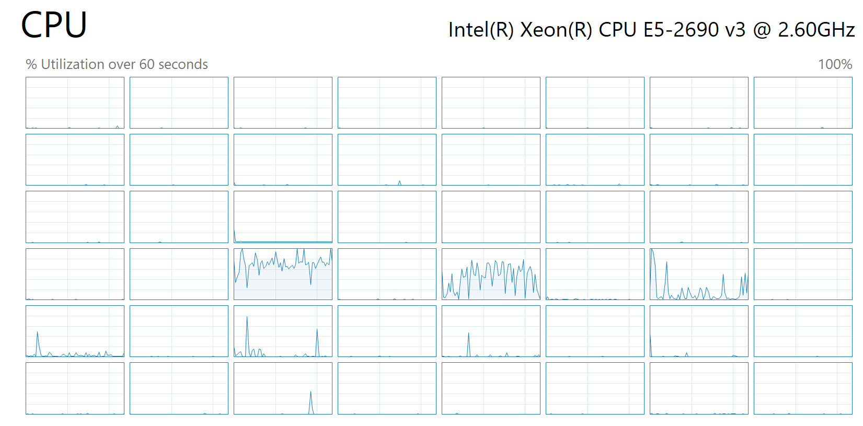
Computer architecture
In DAPOM, you don’t have to worry about the computer architecture; your libraries will handle that.
Your takeaway point is that you should be aware of this. If a program runs slower than you need, look in the task manager at processor utilization.
If you see this, try to revise your algorithm or try to find another library.
Poor
multithreading

Slide 34
Back to DBMS for Big Data
Python itself does a poor job of considering multi-threading, cache prediction, and vectorization.
Similarly, relational databases are not suitable for data analysis with Big Data.
Several new kinds of DBMS’s utilize these tricks much better than standard relational databases. Examples are MongoDB, Cassandra, and Elasticsearch.
These databases are called NoSQL databases, and we use such a database in DAPOM.

Slide 35
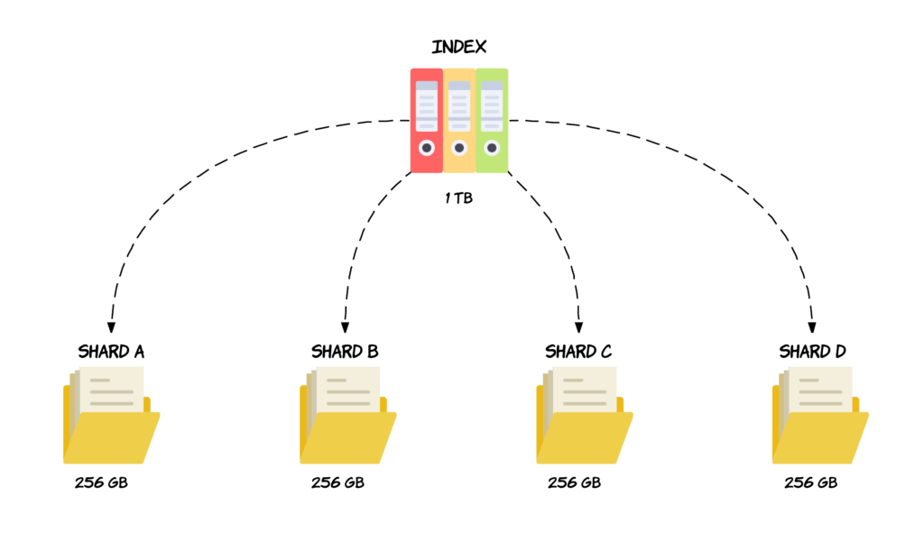
Main differences compared to relational databases - 1
NoSQL Databases are often distributed or ‘sharded’: instead of creating 1 big database, many small databases are created (horizontal scaling).
Each processor core deals with such a small database.
A shard is immutable; it can not be changed. This allows to optimize the internal structure for querying rather than for updating.

Slide 36
Main differences compared to relational databases - 2
NoSQL Databases are document oriented rather than row oriented. This allows hierarchical structures in the data:
{'bsn': 12345,
'age': 40,
'length': 178,
'hobbies': [ 'cars',
'music',
'cocktails'
]
}
In some systems, characteristics/fields do not have to be determined beforehand. This fits reality much better.

Slide 37
Main differences compared to relational databases - 3
Data is stored in columns instead of rows.
Conceptually:
Stored on disk and in memory as:
Relational database: 12345 40 178 54423 45 183 […]
NoSQL: 12345 54423 […] 40 45 […] 178 183 […]
BSN, age, length
12345, 40, 178
54423, 45, 183
[…], […], […]

Slide 38
Main differences compared to relational databases - 3
Stored on disk and in memory as:
Relational database: 12345 40 178 54423 45 183 […]
NoSQL: 12345 54423 […] 40 45 […] 178 183 […]
This makes querying much faster. For example, to get average age of people:
All ages are clustered together and can be copied in one go to the cache of the processor. Iterating through the list with ages is now really fast.
We can use vectorization to sum multiple ages in 1 clock cycle.

Slide 39
TLDR;
NoSQL databases make Big Data possible:
Sharding allows high volume and high velocity
Document orientation allows high variety
Columnar storage allows high velocity
Being able to use a NoSQL database is really important if you do anything with big data.
In DAPOM we use Elasticsearch
Volume
Variety
Velocity

